Slide 1
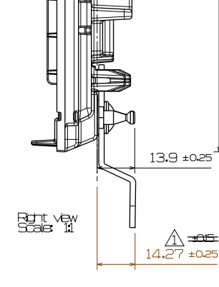
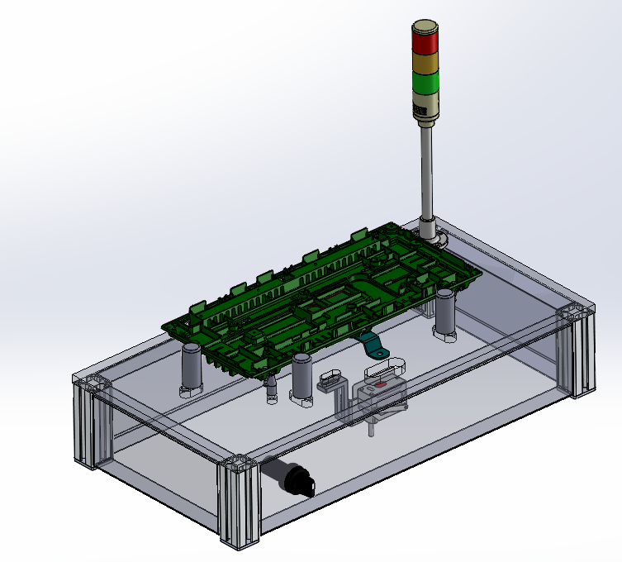
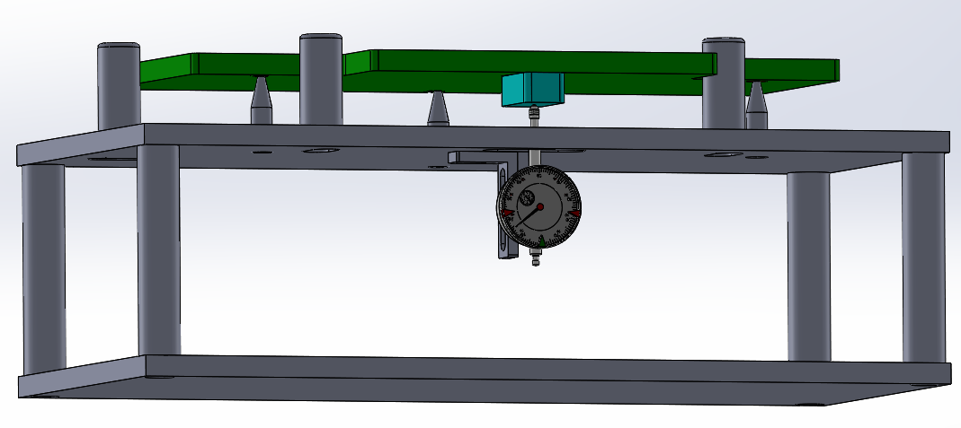
App. Making foolproof for checking Bracket height of Back Cover B34
Automation/ Foolproof
Before
After
Checking Bracket height of Back Cover B34 by manual jig
Cycle time: 15s
Checking Bracket height of Back Cover B34 by Foolproof Jig
Cycle time: 10s
Schedule
Effect
Design Jig : 20. Dec (R&D) (Doing)
Making Jig and set up: 30.Dec (R&D). (done)
Improve quality by automation.
Reduce time for checking 15s → 10s

Slide 2
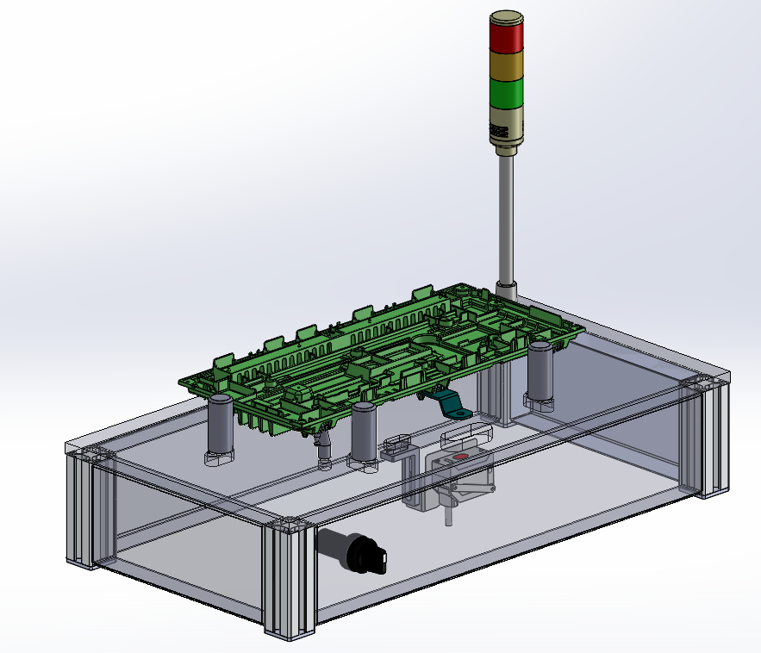
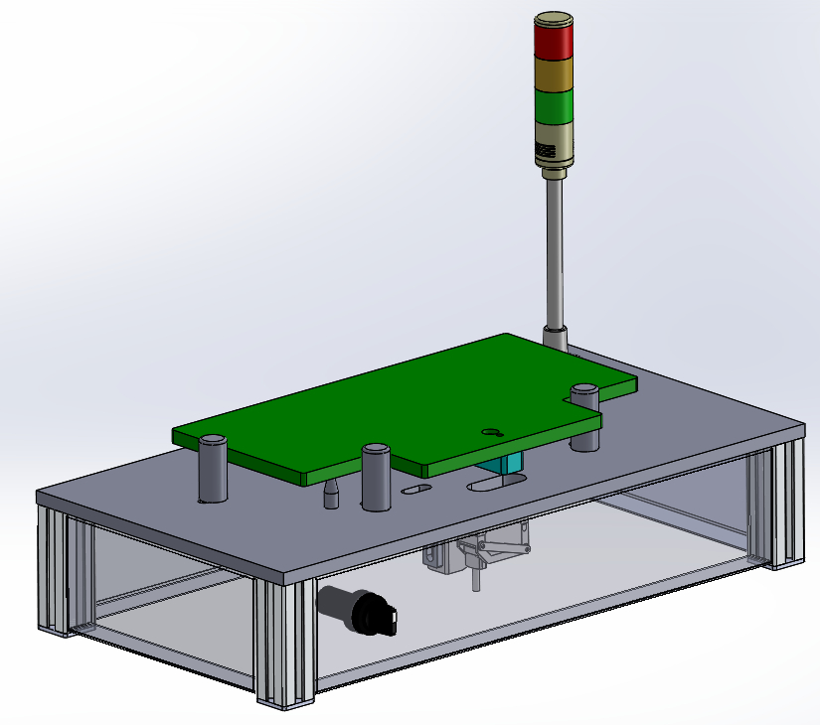
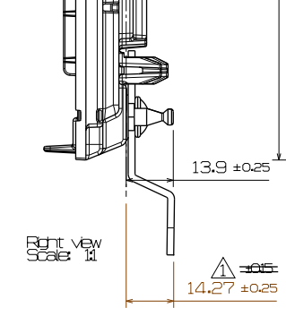
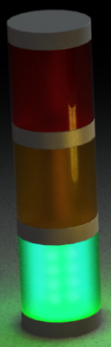
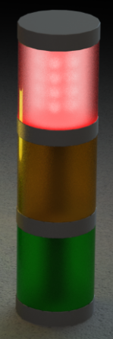
1. JIG Design Information
JIG Picture
Foolproof check height bracket of Back Cover B34
2
4
No. | Part Name | Q'ty | Material | Remark
1 | Base plate | 1 | SUS 201
2 | Back Cover B34 | 1 | SUS 201
3 | Sensor | 1 | IL-030 (Keyence)
4 | Lamp and light | 1
5 | Standard plate | 1 | SUS 201
1
3
5
Operation
Bracket height spec of Back cover sub assy B34:
Setting origin by Standard plate
Put sample into jig
We can detect sample NG by sensor
OK
NG

